Slide 1

CSCI E-25 Computer Vision
Object Detection
Steve Elston
Copyright 2020, 2021,2022, Stephen F Elston. All rights reserved.

Slide 2
Overview of Object Detection
Goal of object detection is to find, localize and classify objects in an image
Real-world scenes are complex with multiple objects
Must locate and localize objects before classifying objects
Location and localization parameterized by bounding box
Localizing and classifying multiple objects is key to scene understanding
Is a multi-task AI problem
Finding numeric values of bounding box location and dimensions is a regression problem
Classification of objects in bounding boxes is a classification problem
Training models requires a multi-task loss function!
Try it yourself! Object detection is widely used commercially
https://cloud.google.com/vision/automl/object-detection/docs/
https://docs.microsoft.com/en-us/azure/cognitive-services/custom-vision-service/get-started-build-detector

Slide 3

Overview of Object Detection
As alternative can use semantic segmentation
Semantic segmentation is a primary tool for scene understanding
More on this method in another lesson

Slide 4
Lesson Overview
Elements of object detection algorithms
Evolution of object detection algorithms
Parameterization of bounding boxes
Evaluation of object detection algorithms
Multiple prior bounding boxes
Finding priors for bounding boxes
Solving the object detection problem
Working with multiple scales
Integrating datasets involves complex language problem

Slide 5
Elements of Object Detection Algorithms
Object detection algorithms have some common elements
Convolutional Neural Network: CNN creates a feature map which is used to detect and classify objects
Candidate bounding boxes: Multiple candidate bounding boxes are generated for each region
Bounding box maximal suppression: The probability of an object being in each bounding box (objectness), and low probability boxes are suppressed
Minimal bounding boxes: The size of the bounding boxes is adjusted to best fit the objects
Classification: The objects in each bounding box is classified

Slide 6
Overview of Object Detection
What approaches might be used to find objects in a complex scene?
Example: Classical approach
Compute features – e.g. HOGs
Search to localize objects
Classify objects detected
Example: Classical approach
Compute embedding – e.g. PCA
Locate similar patches
e.g. the eigen-faces algorithm
Use deep neural networks
Dramatic increase in accuracy
speed may be sacrificed
Create feature map with CNN
Localize and classify objects

Slide 7

Overview of Object Detection
Object detection is a hard problem - Real-world scenes are cluttered
Hard to uniquely detect and classify all objects
This object is both a vase and a potted plant

Slide 8

Overview of Object Detection
Object detection is a hard problem - Occultation is common in real-world scenes
How many people are in this scene?
Are these heads or people?
What is this object?

Slide 9
Overview of Object Detection
Object detection is a hard problem – Trade-offs of speed, categories and accuracy
Selection of object detection models has multi-dimensional trade-offs
Less confidence in classification with increasing number of categories
Lower complexity straight-through models are faster
Chose model to meet requirements
Complex multi-step models
Increasing model complexity
Increasing number of categories
Increasing confidence –
Classification accuracy
Single shot detectors
Increasing frame rate - speed

Slide 10
Evolution of Object Detection Algorithms
An incomplete list of seminal object detection algorithms
Erhan et. al., 2013, Scalable Object Detection using Deep Neural Networks, introduced the R-CNN algorithm the first widely accepted deep learning object detection algorithm. R-CNN demonstrated a significant improvement in object recognition accuracy over classical methods. However, this algorithm is too slow for real-time video processing.
Girshick, 2015, Fast R-CNN simplified the required computations but still too slow for real-time video.

Slide 11
Evolution of Object Detection Algorithms
An incomplete list of seminal object detection algorithms
Ren et. al., 2016, Faster R-CNN algorithm, but computational complexity of the algorithm was still rather high.
He, et. al. in 2018 Mask R-CNN algorithm exhibits significantly improved object detection accuracy, particularly when there are large numbers of objects, such as flock of birds or a crowd of people. While not efficient enough for real-time video, but accurate for complex scenes

Slide 12
Evolution of Object Detection Algorithms
An incomplete list of seminal object detection algorithms
Single shot real-time object detection algorithms
Lui et. al., 2016, Single shot Multibox Detector performs bounding box fitting, object detection, and classification in one step. This single shot algorithm provides real time performance for video
Redmon, et. al. 2016, You Only Look Once: Uniﬁed, Real-Time Object Detection (YOLO) is an alternative single shot detector. YOLO version 1 suffered from low accuracy
Redmon, et. al., 2016, YOLO 9000: Better, Faster, Stronger (aka YOLO v2) made several improvements over the original algorithm. Included the combination of efficient CNN, larger, integrated training data set.
Redmon, et. al., 2016, YOLOv3: An Incremental Improvement, primarily new CNN.

Slide 13
Parameterization of Bounding Boxes
Need a stable parameterization of 4 parameters of bounding box
Start with a prior or prototype for the bounding box
c_{x}, c_{y} is center of the prior
p_{w} is the width prior
p_{h} is the height prior
The compute the best fit box
b_{x}, b_{y} is center of bounding box
b_{w} is the width of the bounding box
b_{h} is the Hight of the bounding box
p_{w}
p_{h}
c_{x}, c_{y}
b_{x}, b_{y}
b_{h}
b_{w}

Slide 14

Parameterization of Bounding Boxes
Need a stable parameterization of 4 parameters of bounding box
A naive approach is to solve a linear system of equations for parameters, t_{x}, t_{y}, t_{u}, t_{h}:
But parameters of the bounding box are unconstrained!
Solution can be unstable
p_{w}
p_{h}
c_{x}, c_{y}
b_{x}, b_{y}
b_{h}
b_{w}

Slide 15

Parameterization of Bounding Boxes
Need a stable parameterization of 4 parameters of bounding box
A better parameterization is:
The bounding box is now constrained and the parameterization is stable
p₀ is the probability the box contains an object
p_{w}
p_{h}
c_{x}, c_{y}
b_{x}, b_{y}
b_{h}
b_{w}

Slide 16
Evaluation of bounding box proposals
How can we evaluate bounding boxes computed with object detection?
Compare the computed bounding box with the marked bounding box (label)
Use the ratio of the area of the intersection divided by the area of the union
Intersection over union or IoU metric
Range:
0.0 – no overlap
1.0 – perfect match

Slide 17

Evaluation of bounding box proposals
How can we evaluate bounding boxes computed with object detection?
Intersection
Union

Slide 18

Evaluation of bounding box proposals
How can we evaluate bounding boxes computed with object detection?
The closer the prediction is to the ground-truth bounding box the higher the IoU
We say higher IoU predictions have greater confidence
Figure from Balasubramaniam and Pasricha, 2022

Slide 19
Multiple Prior Bounding Boxes
Images can contain many objects
SSD uses a grid to divide the image
Can fit bounding boxes around centroids in each of the grid cells
Use odd grid dimensions so there is a centroid at the center of image

Slide 20

Multiple Prior Bounding Boxes
Images contain many objects
Impose grid over image
Locate objects on the grid

Slide 21
Multiple Prior Bounding Boxes
There are many possible bounding box proposals
Start with a first bounding box proposal, with centroid
Boxes with different aspect ratios and same centroid
Apply non-maximal suppression to box proposals

Slide 22
Multiple Prior Bounding Boxes
Multiple objects in image
Bounding box prototypes center on grid elements
Multiple prior bounding box candidates
SSD uses multiple grids to accommodate multiple scales

Slide 23
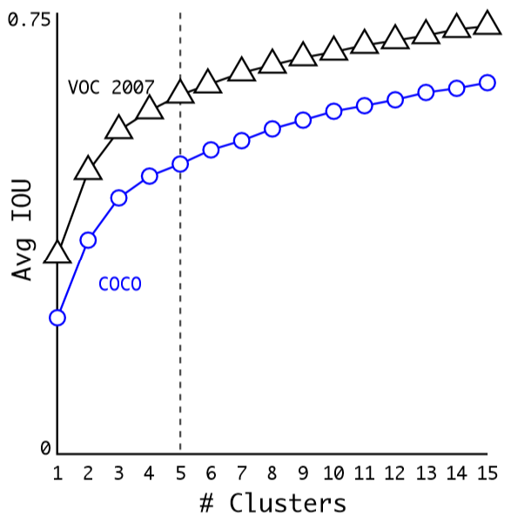
Finding Priors for Bounding Boxes
Good priors are required for solution
Hand picked priors are inefficient
YOLO uses k-means clustering with distance metric
d(box, centroid) = 1.0 – IOU(box, centroid)
How to choose k?
Use k = 5
Conservative value prevent overfitting

Slide 24

Finding Priors for Bounding Boxes
Good priors are required for solution
Priors for VOC and COCO for YOLO models
For both data sets tall and narrow priors are favored

Slide 25

Solving Object Detection Problem
Solve as object detection as regression problem
Find bounding box, objectness, and category (c₁,c₂,…,c_{n}), as label for regression problem

Slide 26

Solving Object Detection Problem
Solve as object detection as multi-task problem
Can formulate the problem with label for multiple bounding boxes.
Solve box as regression problem and classification problem in one step
Use fully convolutional neural networks

Slide 27
Solving Object Detection Problem
Solve as object detection as regression problem
Find most probable bounding box with non-max suppression algorithm:
Filter all boxes with p₀ below threshold, say 0.5
While( more than one overlapping box ):
Select the remaining boxes with the highest probability
Compute the IoU for overlapping bounding boxes
Compute probability of objects in boxes, P(ci)
Suppress (filter out) bounding boxes with f(IoU, P(ci)) below threshold, say 0.6.

Slide 28
Solving Object Detection Problem
Find most probable bounding box with non-max suppression algorithm:
Most bounding boxes will not optimally contain an object
Imbalance with many more true negatives than true positives
Can lead to poor model training
SSD solves this problem with a hard negative mining algorithm:
Sort bounding boxes by confidence score
Retain only most confident cases to maintain a 3:1 ratio of negative to positive cases.

Slide 29
Loss functions for object detection
How can we construct a multi-task loss function for this problem?
Execute tasks sequentially
First step identify bounding box
Second step classify objects
Each step trained individually with specific loss function
Examples include R-CNN algorithm
Multiple steps are inherent performance bottleneck
Combine tasks
Use a multi-task loss function for training
Used in efficient single shot algorithm
Algorithms include SSD and YOLO

Slide 30
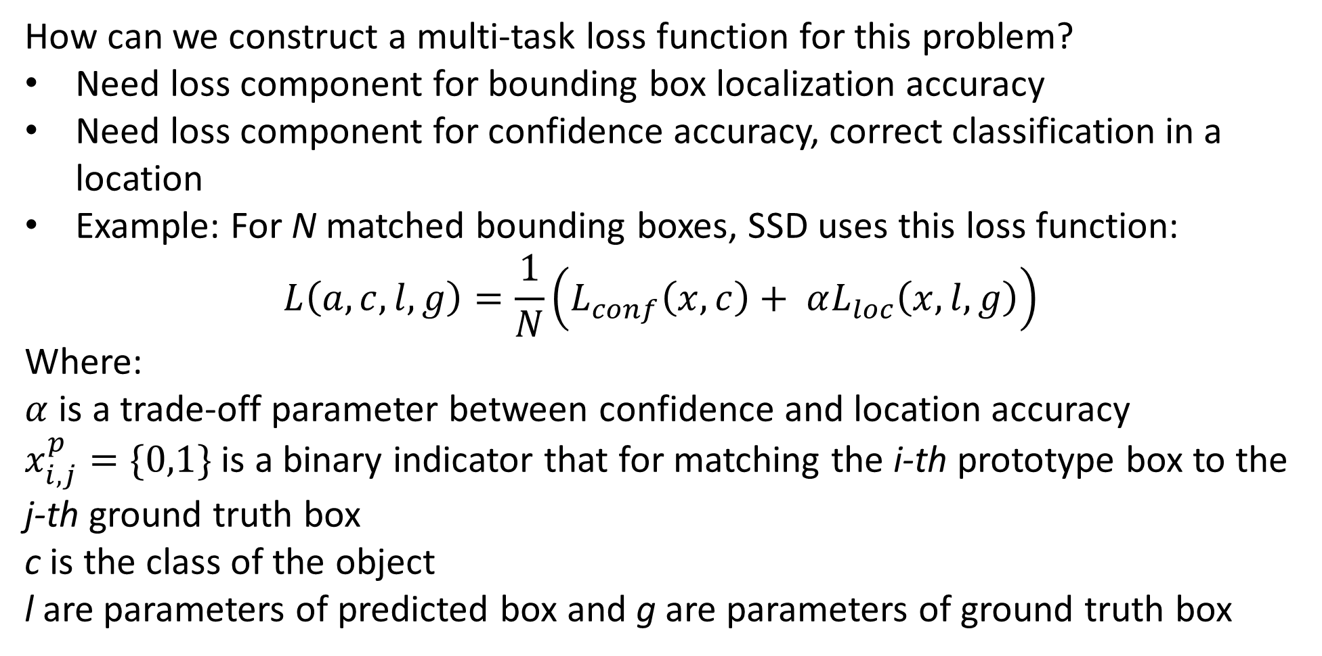
Loss functions for object detection
How can we construct a multi-task loss function for this problem?
Need loss component for bounding box localization accuracy
Need loss component for confidence accuracy, correct classification in a location
Example: For N matched bounding boxes, SSD uses this loss function:
$$L\left(a,c,l,g\right)=\frac{1}{N}\left(L_{conf}\left(x,c\right)+ αL_{loc}\left(x,l,g\right)\right)$$
Where:
$α$ is a trade-off parameter between confidence and location accuracy
$x_{i,j}^{p}=\{0,1\}$ is a binary indicator that for matching the i-th prototype box to the j-th ground truth box
c is the class of the object
l are parameters of predicted box and g are parameters of ground truth box

Slide 31
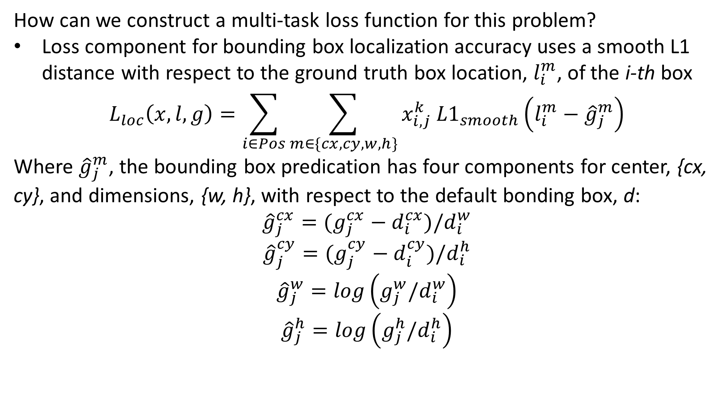
Loss functions for object detection
How can we construct a multi-task loss function for this problem?
Loss component for bounding box localization accuracy uses a smooth L1 distance with respect to the ground truth box location, $l_{i}^{m}$, of the i-th box
$$L_{loc}\left(x,l,g\right)=\sum_{i∈Pos}^{ }{\sum_{m∈\{cx,cy,w,h\}}^{ }{x_{i,j}^{k} {L1}_{smooth}\left(l_{i}^{m}−{\hat{g}}_{j}^{m}\right)}}$$
Where ${\hat{g}}_{j}^{m}$, the bounding box predication has four components for center, {cx, cy}, and dimensions, {w, h}, with respect to the default bonding box, d:
$${\hat{g}}_{j}^{cx}=(g_{j}^{cx}−d_{i}^{cx})/d_{i}^{w}$$
$${\hat{g}}_{j}^{cy}=(g_{j}^{cy}−d_{i}^{cy})/d_{i}^{h}$$
$${\hat{g}}_{j}^{w}=log\left(g_{j}^{w}/d_{i}^{w}\right)$$
$${\hat{g}}_{j}^{h}=log\left(g_{j}^{h}/d_{i}^{h}\right)$$

Slide 32
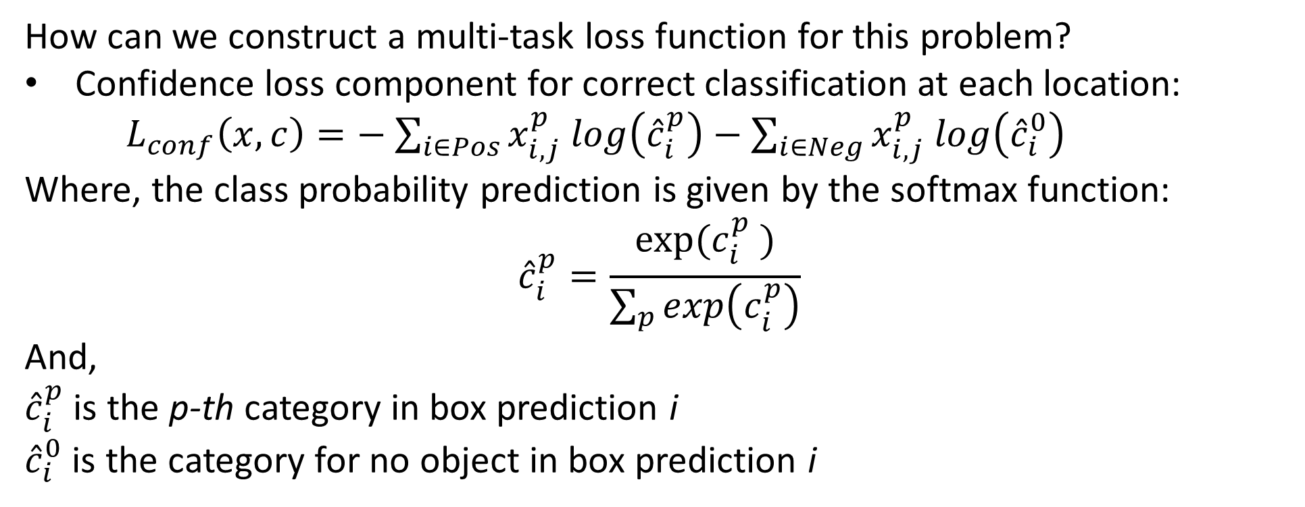
Loss functions for object detection
How can we construct a multi-task loss function for this problem?
Confidence loss component for correct classification at each location:
$L_{conf}\left(x,c\right)=−$ $\sum_{i∈Pos}^{ }{x_{i,j}^{p} log\left({\hat{c}}_{i}^{p}\right)}−\sum_{i∈Neg}^{ }{x_{i,j}^{p} log\left({\hat{c}}_{i}^{0}\right)}$
Where, the class probability prediction is given by the softmax function:
$${\hat{c}}_{i}^{p}=\frac{exp⁡({c_{i}^{p}}_{ }^{ })}{\sum_{p}^{ }{exp\left(c_{i}^{p}\right)}}$$
And,
${\hat{c}}_{i}^{p}$ is the p-th category in box prediction i
${\hat{c}}_{i}^{0}$ is the category for no object in box prediction i

Slide 33
Evaluation of object detection
Need multiple criteria to evaluate object detection
Is there an object in the box?
Is the bounding box correct?
Is the object classification in the box correct?
Need metrics for accuracy of bounding box and object class predictions
Average precision measured on recall-precision trade-off curve
Use mean average precision – mAP
Mean taken over average precision over all object classes

Slide 34
Evaluation of object detection
Review of classification model metrics
Classifiers perform an hypothesis test with possible outcomes:
True positive (TP): Positive cases are correctly classified
True negative (TN): Negative cases are correctly classified
False positive (FP): Negative case erroneously classified as positive
False negative (FN): Positive case erroneously classified as negative
These quantities can be organised into a confusion matrix:
 | Actual Positive | Actual Negative
Classified Positive | TP | FP
Classified Negative | FN | TN

Slide 35
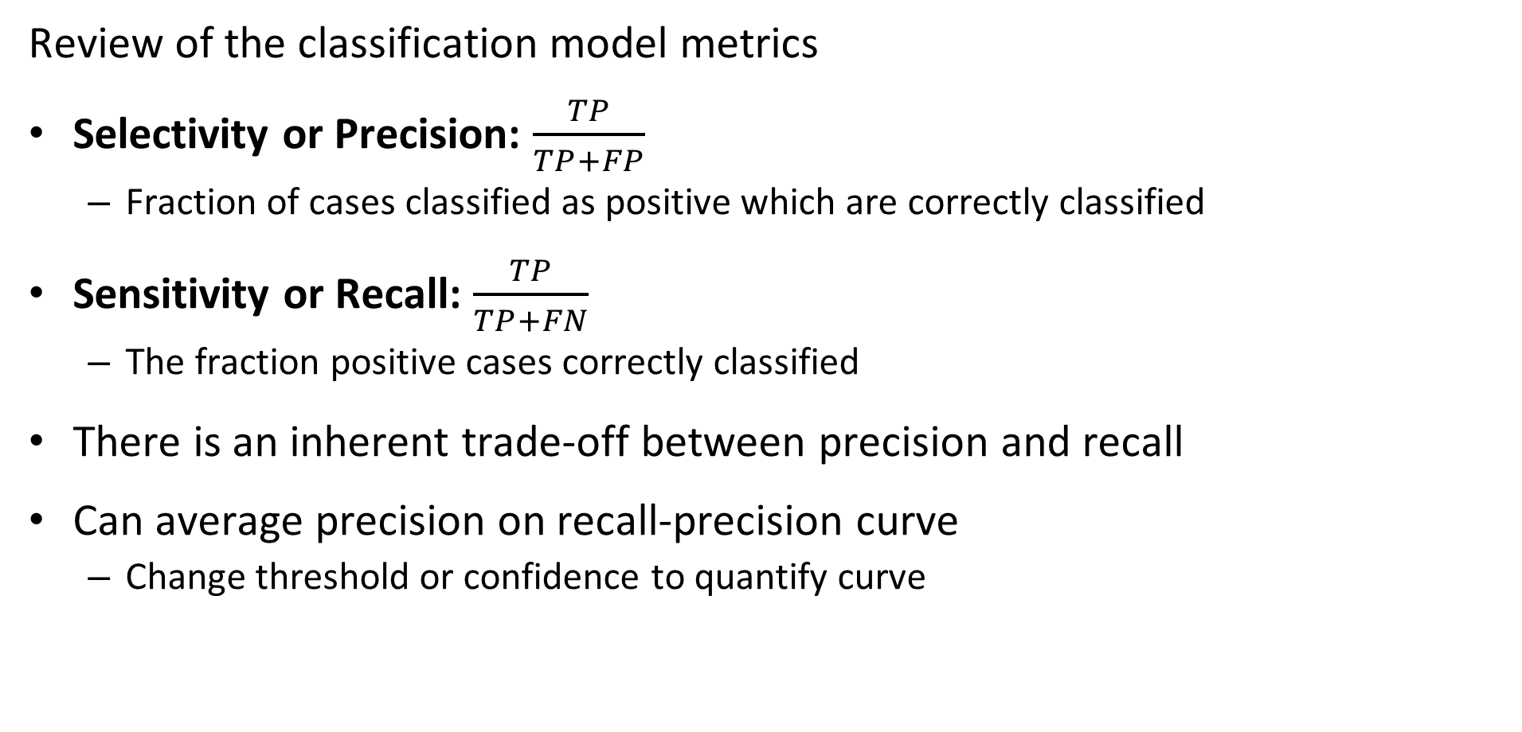
Evaluation of object detection
Review of the classification model metrics
Selectivity or Precision: $\frac{TP}{TP+FP}$
Fraction of cases classified as positive which are correctly classified
Sensitivity or Recall: $\frac{TP}{TP+FN}$
The fraction positive cases correctly classified
There is an inherent trade-off between precision and recall
Can average precision on recall-precision curve
Change threshold or confidence to quantify curve

Slide 36
Evaluation of object detection
Computing Average Precision - AP
Precision decreases as recall increases
Recall increases as confidence (IoU) increases
Average precision is Area Under the Curve (AUC) of precision-recall curve
Approximate AUC as sum of area of rectangles at each threshold sample
Usually sample precision at 10 threshold (IoU) values
Precision
Increasing threshold, IoU
Increasing Recall

Slide 37
Evaluation of object detection
Computing mean average precision - mAP
Compute average precision for each of c classes
Compute mean of precision for all c classes
Report mAP as percentage
Prefect performance = 100%
No correct detection and classification = 0%

Slide 38
Working with multiple scales
Images contain objects a multiple scales
Need to detect objects across wide range of scale
Is trade-off between semantics and detail
Large scale has better semantics
Fine scale has more detail
Deep neural network architecture produces multiple scales
Convolution with max pooling reduces detail
Deeper layers with better symantics

Slide 39

Working with multiple scales
Convolutional neural network with multi-scale feature map (pyramid)
Predict
Convolution/max-polling layers
Predict
Multi-scale bounding boxes
Predict
Image
Convolution/up-sampling

Slide 40
Working with multiple scales
Convolutional neural network with multi-scale feature map (pyramid)
Predict
Fractional stride convolution/up-sampling
Predict
+
Predict

Slide 41

Working with multiple scales
Example Single Shot Detector, SSD
SSD takes a different approach to the speed-accuracy trade-off
SSD achieves efficiency by scoring multiple bounding boxes at different scales simultaneously using convolutional layers

Slide 42
Working with multiple scales
Example Single Shot Detector, SSD
VGG-16 Convolutional Layers
Create feature map

Slide 43
Working with multiple scales
Example Single Shot Detector, SSD
Convolutional Layers down sample to multiple scales
Detection and classification on grids

Slide 44
Working with multiple scales
Example Single Shot Detector, SSD
Output layers
Output for each box and class

Slide 45
Working with multiple scales
Example Single Shot Detector, SSD
SSD is a fully convolutional network
No fully connected layers

Slide 46
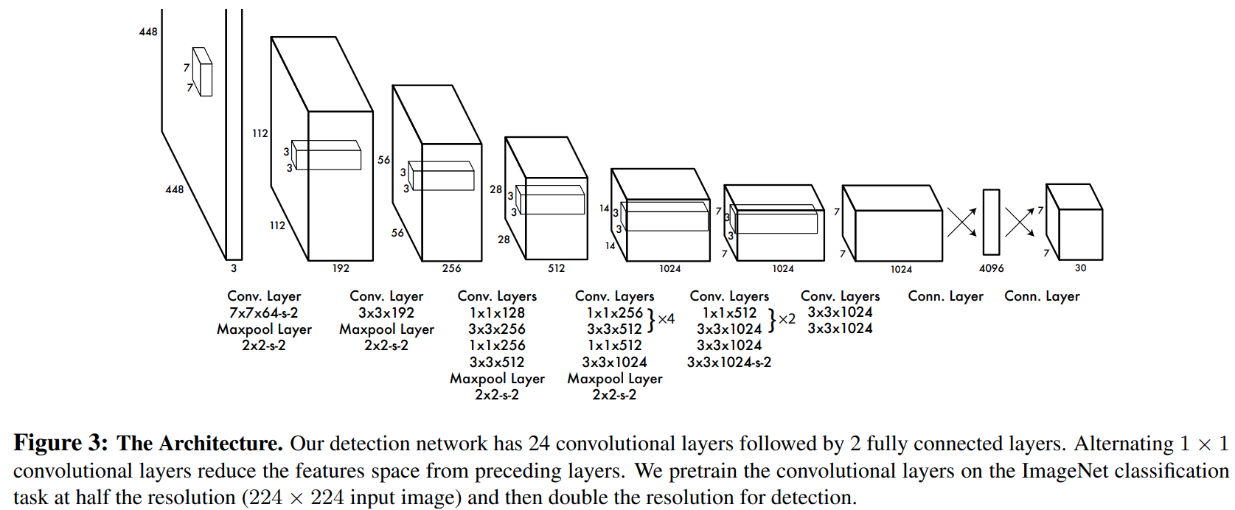
YOLO architecture
YOLO V2 uses a straight though fully convolutional neural network
All scales are processed in single CNN pipeline
Must use overlapping and multiple scale bounding boxes

Slide 47

Performance comparison and trade-offs
YOLO uses overlapping bounding boxes at multiple scales
Starts with a grid of anchor boxes on a single grid
Priors for multiple scale bounding boxes around anchor boxes
Maximal suppression of bounding boxes using probability map
Result is bounding boxes at multiple scales
From Redmon, et. al. 2016

Slide 48
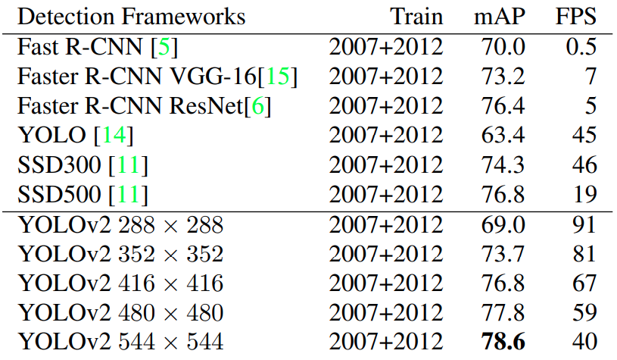
Performance comparison and trade-offs
Accuracy and performance trade-off
Single shot models are much faster
Lower accuracy (lower input image dimensions) gives greater speed
Single shot detectors capable of video speeds
From Redmon, et. al., 2016

Slide 49
Datasets for training
Lui, et. al., 2016, applied the following data augmentation methods
Use the entire original input image
Sample a patch so that the minimum jaccard overlap with the objects is 0.1, 0.3, 0.5, 0.7, or 0.9
Randomly sample patches

Slide 50
Integrating Datasets
Need to integrate multiple datasets
Difference in number of cases between training datasets
ImageNet is extensive, but only for classification, no bounding boxes
Classification datasets with marked bounding box are more limited
Must integrate these datasets for training
ImageNet uses compound words, e.g. Labrador retriever
Marked bounding box data uses simple words: e.g. retriever or dog
Semantics of the classification categories are rather different!
Must resolve mismatch to integrate datasets

Slide 51
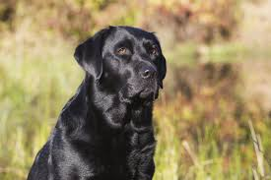
Semantics of Language is Complex
ImageNet uses a flat hierarchy for classification
What is this?
….
German Shepard
Labrador Retriever
Great Dane
Calico
Spaniel
Tuxedo
Siamese
tabby

Slide 52
Semantics of Language is Complex
Human language classifies the same object into multiple categories
WordTree uses a complex hierarchy
….
Object
….
Animal
Mammal
….
Pet
What is this?
Dog
Cat
Guard
Short hair
Long hair
Retriever
Springer Spaniel
Labrador Retriever
German Shepard
Great Dane
Tuxedo
tabby
Siamese
Maine Coon

Slide 53
Semantics of Language is Complex
Human language classifies the same object into multiple categories
What are the conditional probabilities?
Computation depends on semantics!
p(object)
Object
….
p(animal|object)p(object)
Animal
Pet
What is this?
p(mamal|animal)…p(object)
Mammal
Dog
p(pet|…)…p(object)
p(dog|mamal)…p(object)
p(dog|pet)…p(object)
p(retriever|dog)…p(object)
Retriever
p(Labrador retriever|retriever)…p(object)
Labrador Retriever

Slide 54
Integrating Datasets
Need to integrate multiple datasets
Integration of the datasets requires integration of classification terms
Integrate terms by shortest path on WordTree
Use common term to integrate bounding box and extensive classification categories

